Slide 1
Concept of smthng
Lisiutin Andrey
Lisiutin Sergei
Khuziakhmetov Ayrat

Slide 2
Tasks:
Find my location
Surrounding events
Tag (Actor) e.g Putin –routes for a certain period of time
Tag e.g. Putin – related events for a certain period of time
Account for user + recently viewed or most frequent viewes
Filters – TOP 5 events for a certain period

Slide 3
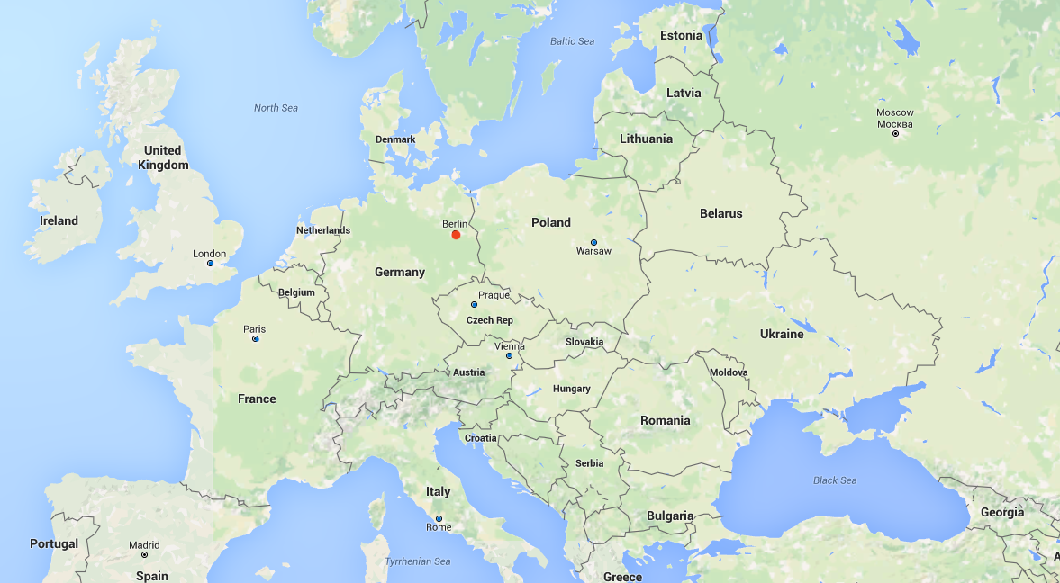
Zoom

Slide 4
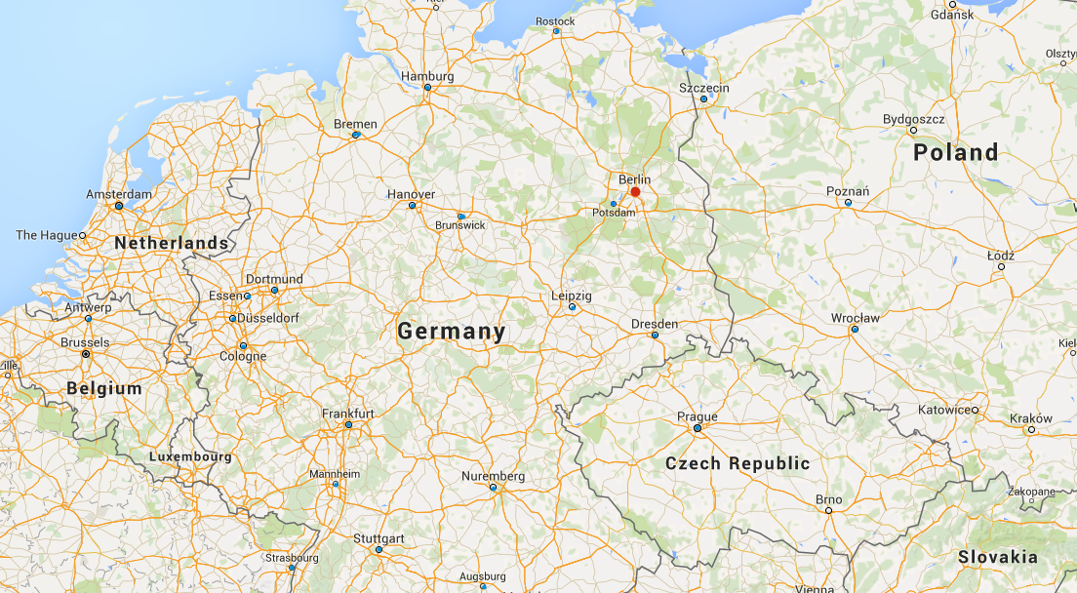

Slide 5
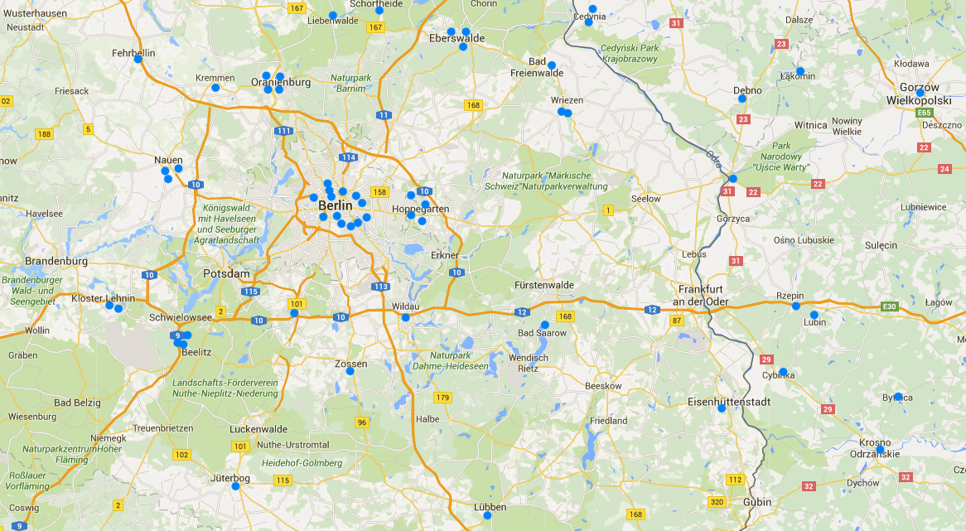

Slide 6
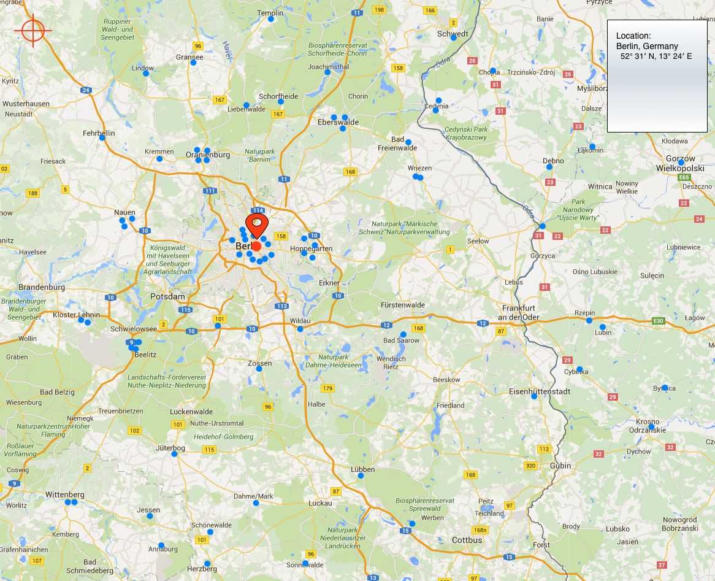
Task 1: find my location

Slide 7
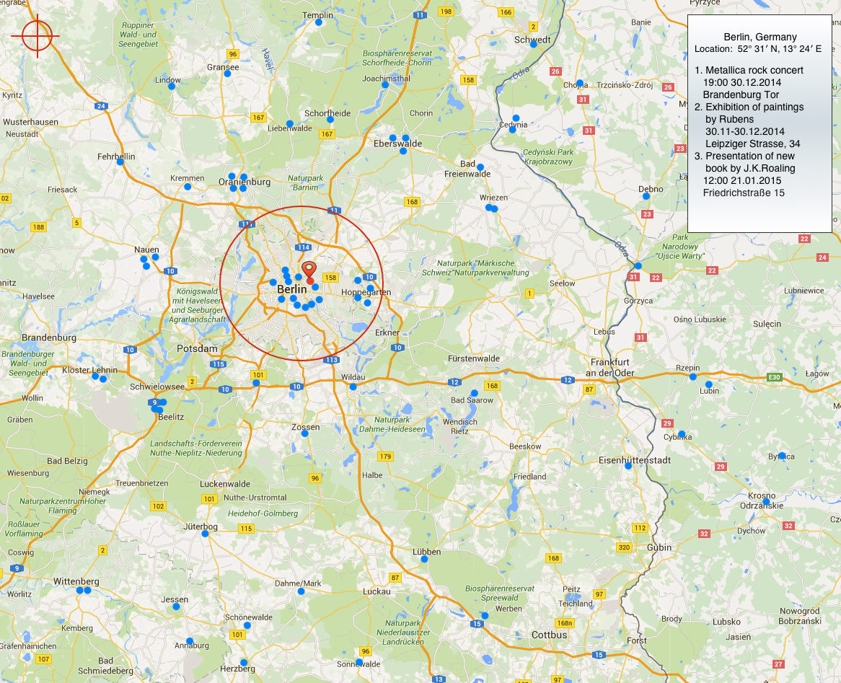
Task 2: Surrounding events

Slide 8
Task 3: routes of actor for a certain period

Slide 9
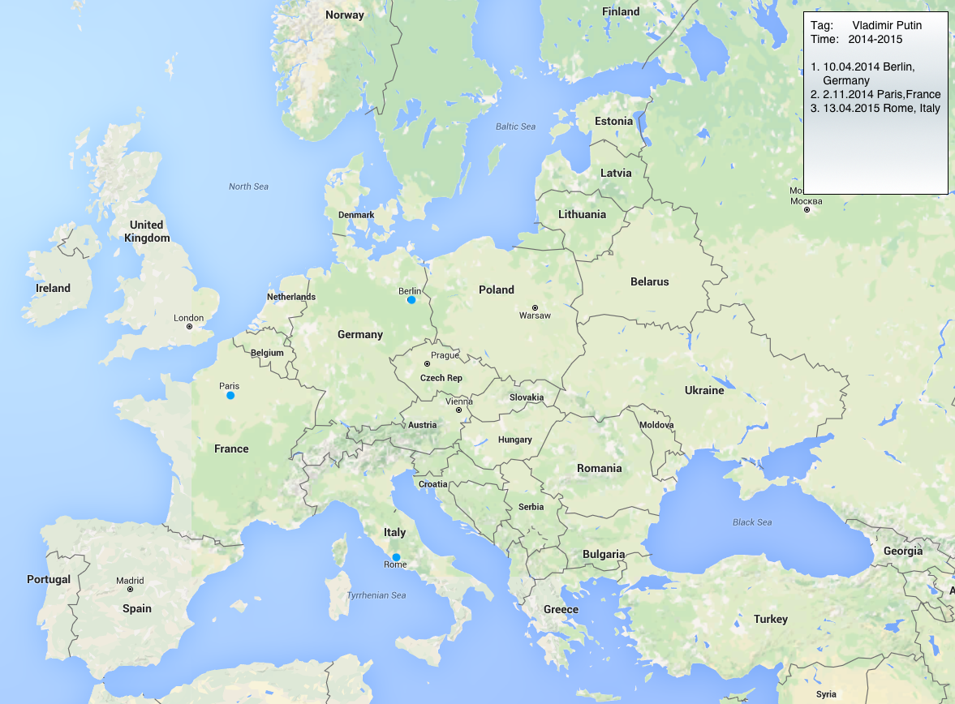
Task 4: related with tag events for a certain period

Slide 10
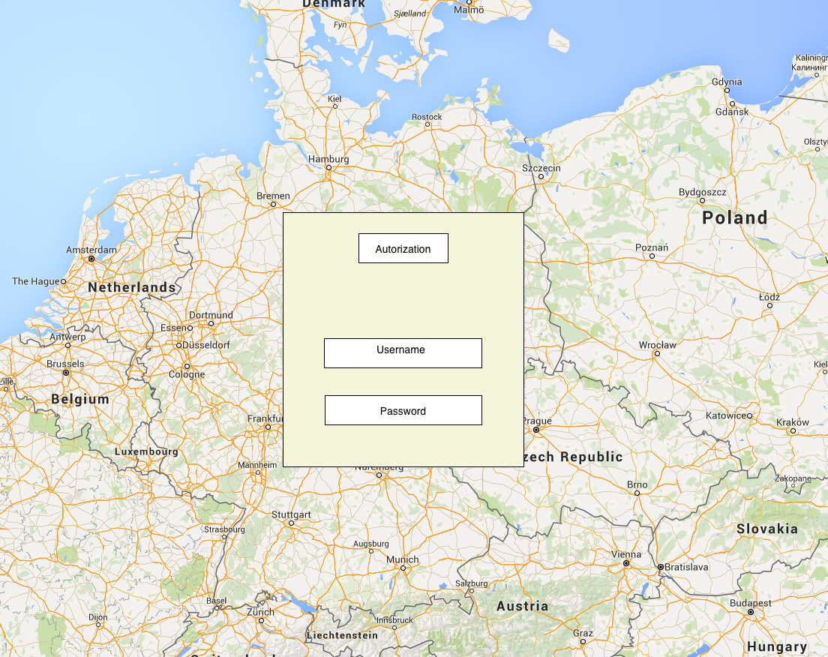
Task 5: Account for user + recently viewed or most frequent views

Slide 11
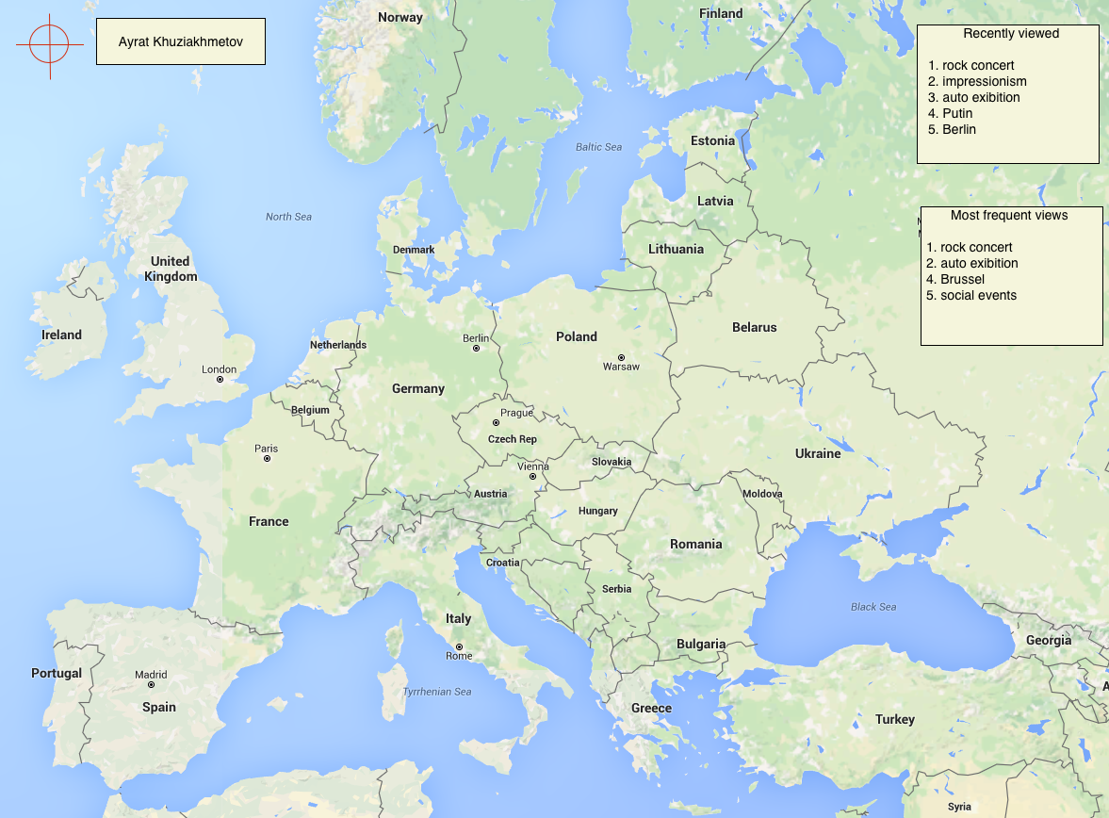

Slide 12
Task 6: Filters – TOP 5 events for a certain period

Slide 13
Plan
01.12 get task
07.12 prepare plan
14.12 install software, studying play framework
5.01 prototype
21.01 coding
01.02 testing
07.02 documentations

